Slide 1
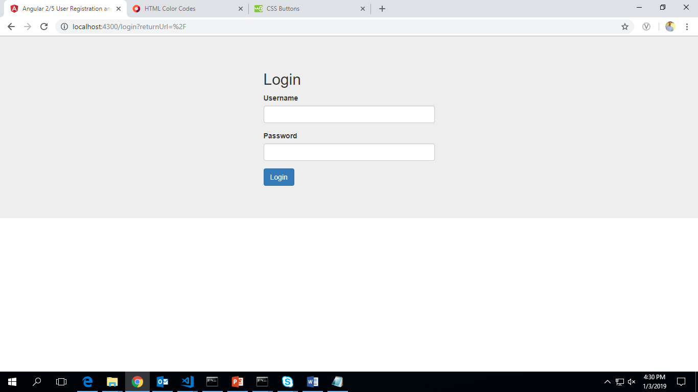

Slide 2
2.Employee DashBoard
Apply Optional Holiday
Apply Leave
Cancel Approved Leaves
Planned Leaves
(Shown Here)

Slide 3
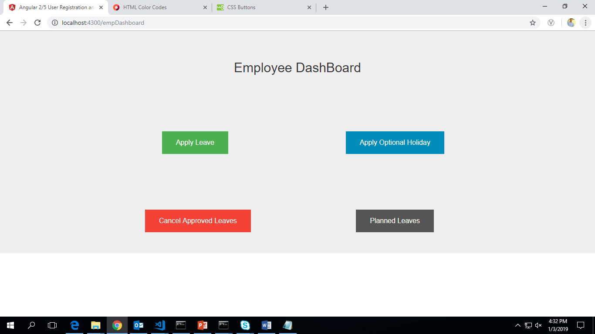

Slide 4
3.Apply Leave Page
Leave Application:- Holiday Calendar
Year:- Dropdown DC:- Automatic
From date:-Calendar
To Date:-Calendar
Reason for Leave:-Textbox
To be approved by:-Filled Automatically
Optional Holiday:-Yes/No
Apply & Reset

Slide 5
4.Cancel Approved Leaves
Leave Account Balance
Leave Account | Credit | Debit | Balance
My Leave Requests
From | Unit | To | Status | No of Leaves | Applied on | Remarks | Approver | Action

Slide 6
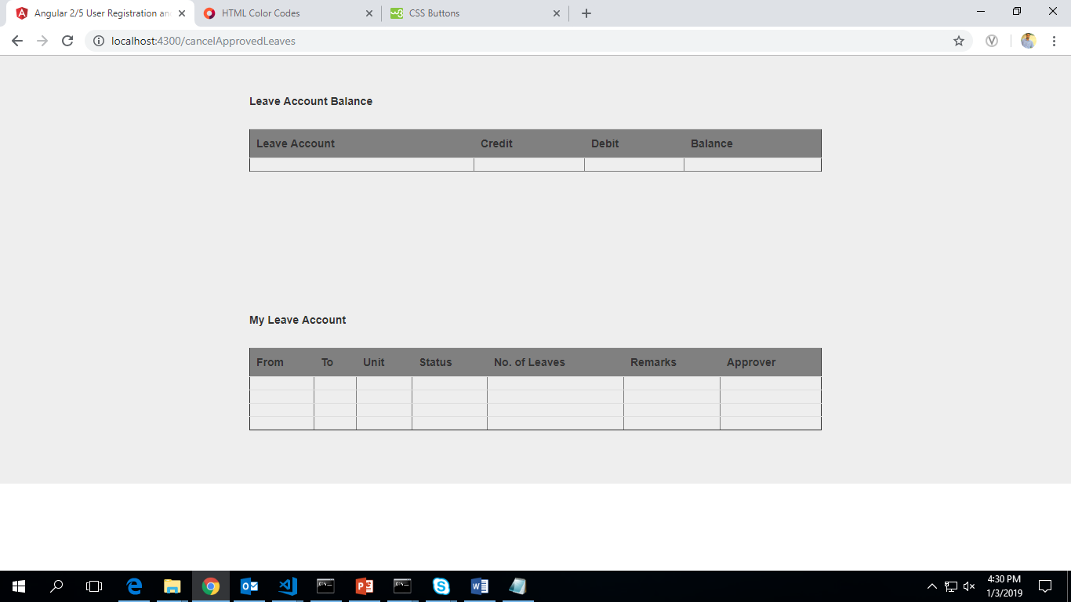

Slide 7
6.Manager DashBoard
Employee No. | Employee Name | From | Unit | To | No of Leaves | Applied on | Action | Remarks
Apply Leaves(Button)
Upload Time Sheet
Upload RT Sheet
Add/Delete Employees
Update Roles and Rates
Generate Task Order
Generate Billing Status(Button)

Slide 8
9.Add/Delete Employees
Add Employee
Employee No:-Number
Name:-Text
Unit:-Text
Reporting Manager Emp Id:-Number
Location:-Dropdown
DC:-Dropdown
Designation:-Dropdown
Delete Employee
Employee No. | Name | Action | Remarks

Slide 9
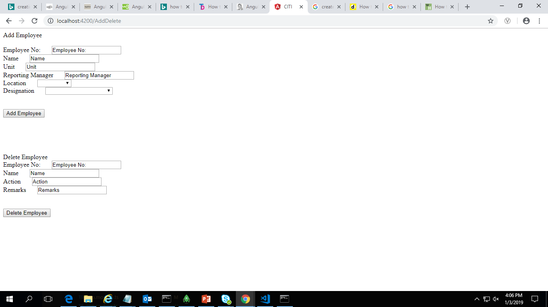

Slide 10
10.Update Roles and Rates
Role:-Dropdown
Currency:-Dropdown(USD,INR,GBP)
Pay per Day:-Number
Add/Delete Role:-Text Add | Delete
Add/Delete Currency:-Text Add | Delete
Add/Delete Location:-Text Add | Delete
Add/Delete DC:-Text Add | Delete
Add/Delete Role:-Text Add | Delete
Role | Currency | Pay per Day

Slide 11
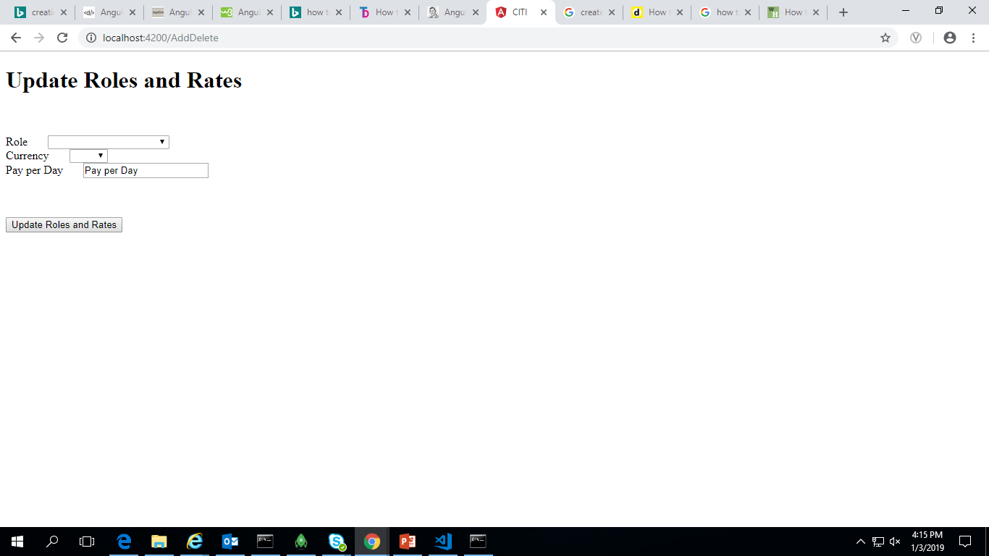

Slide 12
11.Update Timesheet
Year:-Dropdown
Month:-Dropdown
if not present-Button
Present-Excel Sheet

Slide 13
15.Upload RT Sheet

Slide 14
16.Admin Login
Update Holiday/Optional Holiday
Add/Delete Managers

Slide 15
17.Update Holiday List
Add Holiday:-
1.DC:-Dropdown
2.Year:-Dropdown
3.Date:-Calendar
4.Holiday:-Text
5.Optional Holiday:-Yes/No
Delete Holiday:-
1.DC:-Dropdown
2.Year:-Dropdown
3.Date:-Calendar
4.Optional Holiday:-Yes/No

Slide 16
18.Add/Delete Managers
Add Managers:-
1.Manager No:-Number
2.Manager Name:-Text
3.Unit:-Text
4.Location:-Dropdown
5.Role :-Dropdown
Delete Managers:-
1.Manager No:-Number
2.Replacement Manager:-Number(ManagerNo)

Slide 17
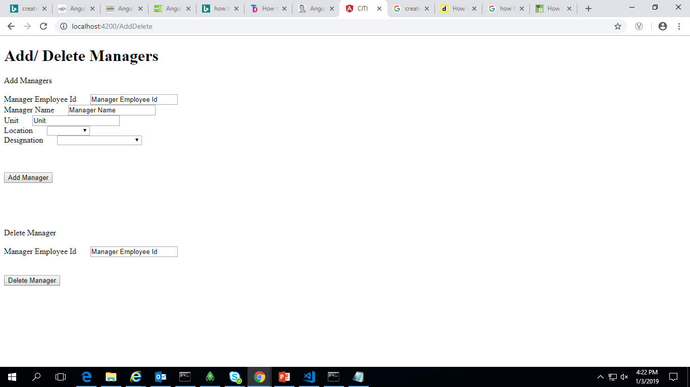

Slide 18
Database Design

Slide 19
I . Employee Table
1. Employee No.:- Number
2. Employee Name:- Varchar
3. Billing Start Date:-Date
4.Billing End Date:-Date
5. Approver:- Varchar
6. Location:- Varchar
7. Role:- Varchar
8.Currency:-Varchar
9.Rate per Hour:-Number
10.DC:-Varchar
3.Application:- Varchar
8.Daily Rate:-Number
Composite Primary Key:- Employee No
Employee No | Employee Name | Billing Start Date | Billing End Date | Approver | Location | Role | Currency | Rate per Hour | Daily Rate | DC | Application | Adjustment(Last Month)
1007809 | Aayush Shrivastava | 23-Aug-2018 |  | 177161 | India | Systems Engineer | INR | 2520 | 20160 | Pune

Slide 20
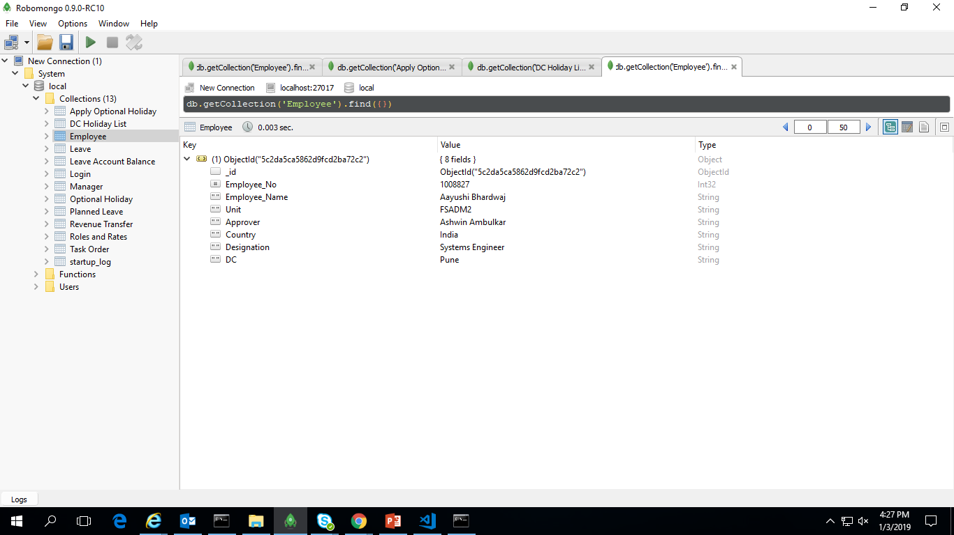

Slide 21
II . Manager Table
1.Manager No:-Number
2.Manager Name:-Varchar
3.Unit:-Varchar
4.Location:-Varchar
5.DC:-Varchar
6.Role:-Varchar
Primary Key:-Manager Id
Manager No | Manager Name | Unit | Location | DC | Role
273512 | Ankit Singh | FSA3DM | India | Indore | Project Manager

Slide 22
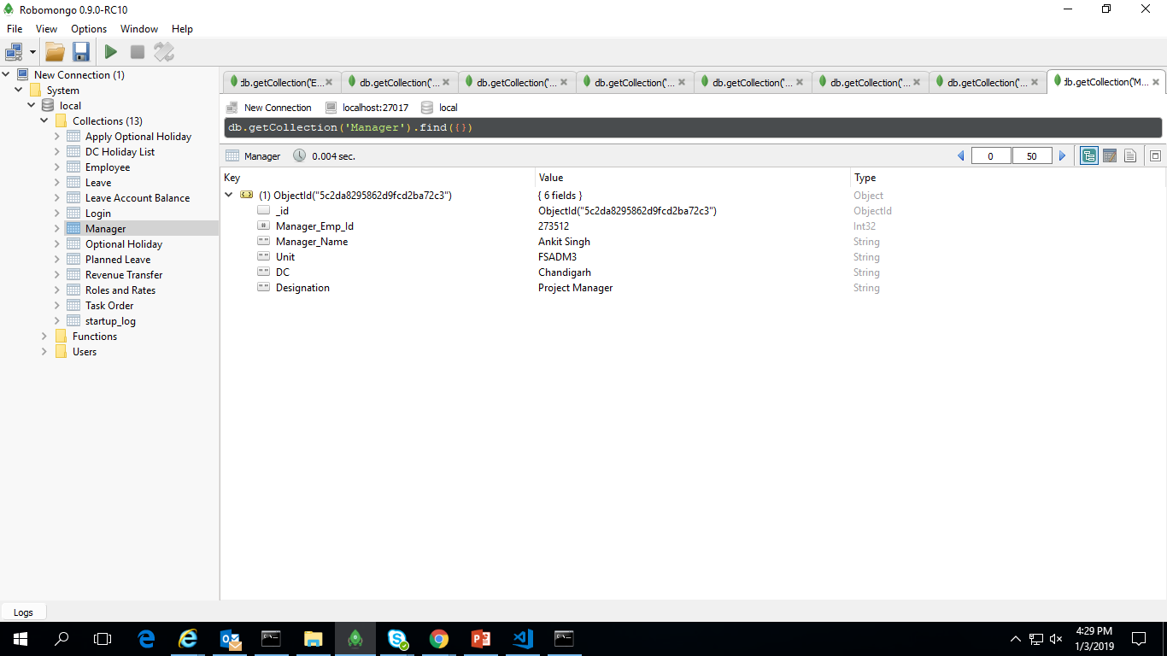

Slide 23
III. Login Table
1.UserName: Varchar
2.Password:password
3.Log_Status:Integer(1-Active,0-Inactive)
Primary Key : UserName
UserName | Password | Log_Status
Aayush.shrivastava | ab@ad.nf | 0

Slide 24
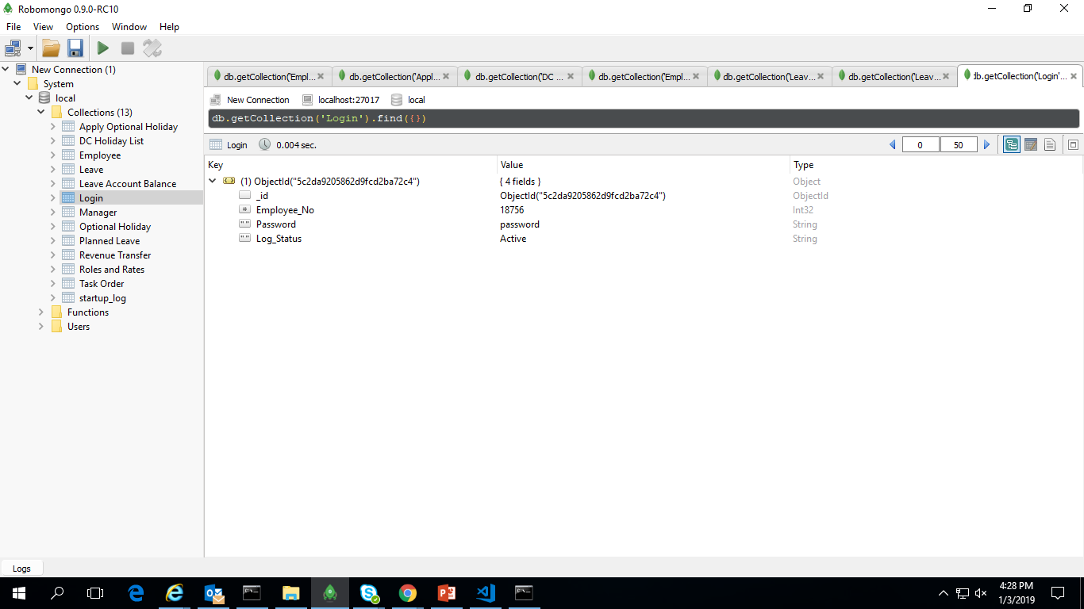

Slide 25
IV. DC Wise Holiday Tables
1. Date:- Date
2.Location:-Varchar
3. DC:- Varchar
4.Optional Holiday:-Integer(0-No,1-Yes)
5.Year:-Number
Composite Primary Key:- Date+ Location+ DC
Date | Location | DC | Optional Holiday | Year
26-Jan-2018 | India | Bangalore | 0/1 | 2018

Slide 26
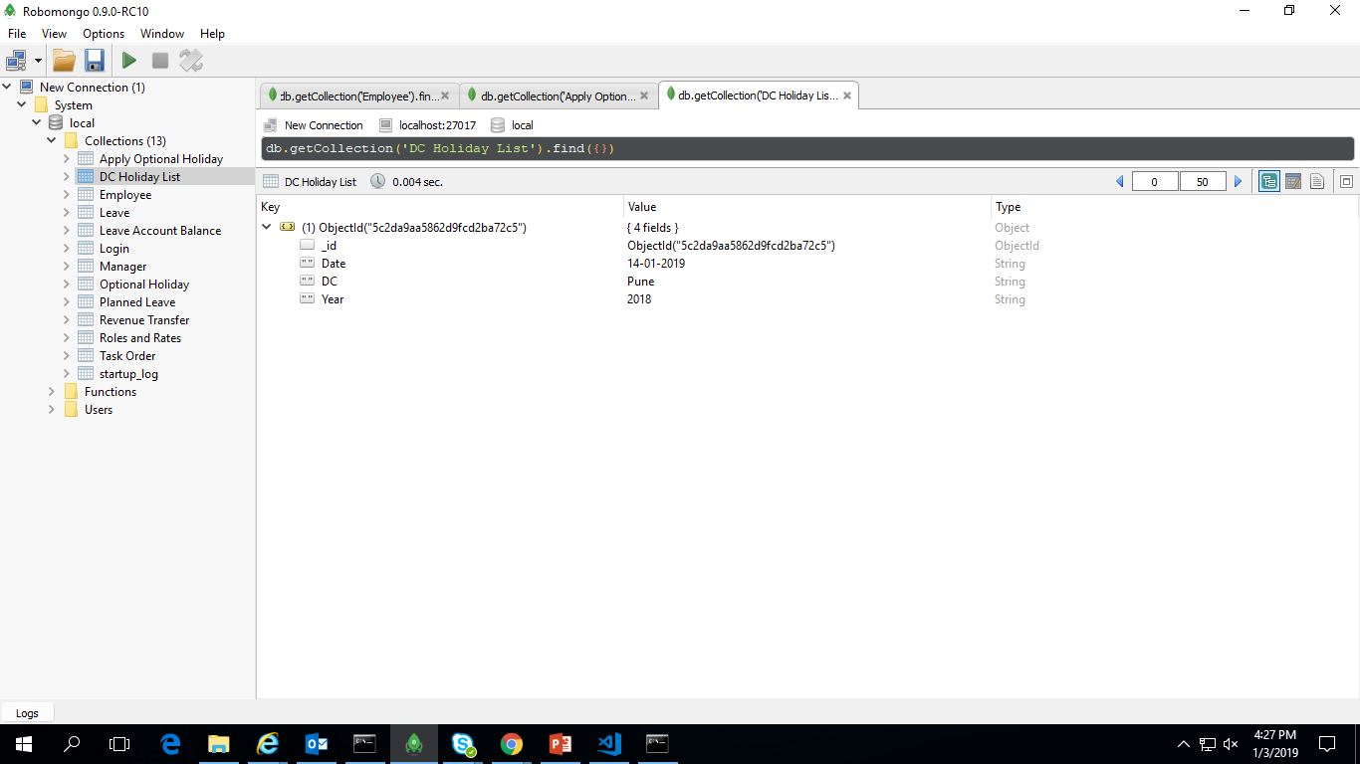

Slide 27
V. Leave Table
1.Employee No.:- Number
2.Leave Type:-Integer(0-Optional,1-Regular)
2.From:- Date
3.To:- Date
4.Reason:- Varchar
5.Approver:- Varchar
6.Unit:- Varchar
7.Status:- Integer(0-Submitted,1-Approved,2-Rejected)
8.No.of Leaves:- Number
9.Remarks:- Varchar
Primary Key:-Employee No
Foreign Key:-Approver(From Employee)
Employee No. | Leave Type | From | To | Reason | Approver | Unit | Status | No. of Leaves | Remarks
1008827 | 1 | 21-Jan-2019 | 25-Jan-2019 |  | 717659 | FSADM2 | 0 | 2

Slide 28
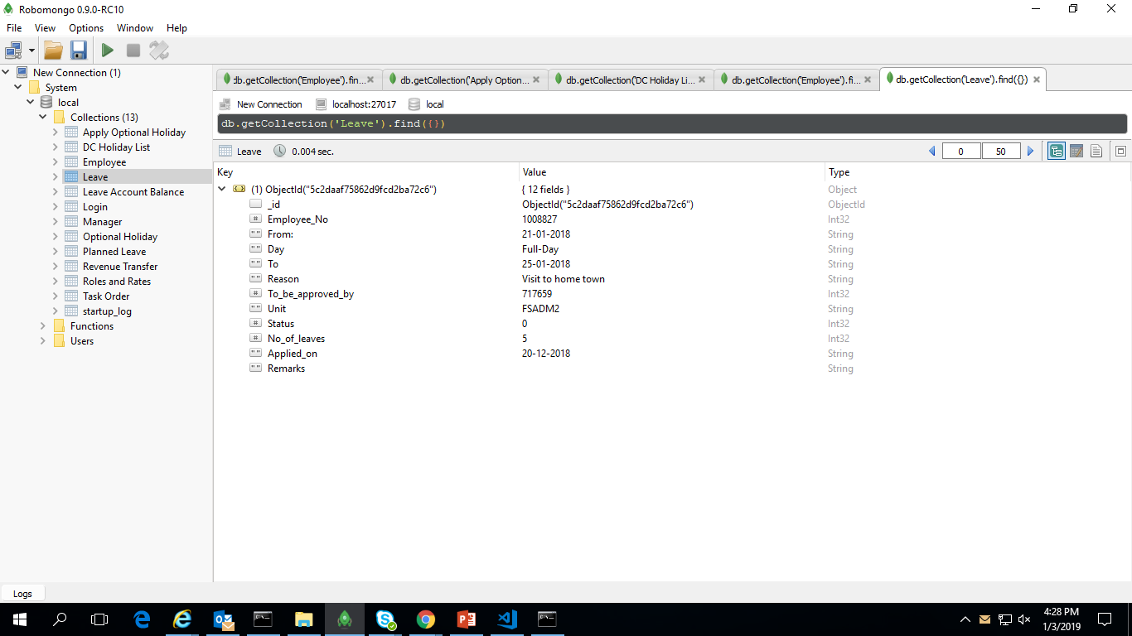

Slide 29
VI. Leave Account Balance Table
1.Employee No.:- Number
2.Leave Account:- Varchar
3.Credit:- Number
4.Debit:- Number
5.Balance:- Number
Primary Key:-Employee No
Employee No. | Leave Account | Credit | Debit | Balance
1008676 | EL | 7 | 2 | 5

Slide 30
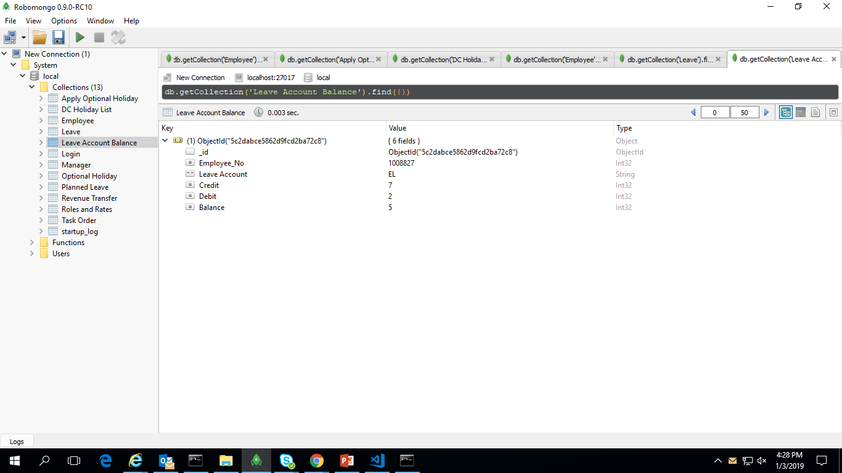

Slide 31
VII. Revenue Transfer Table
1.Employee No :-Number
2.Track:-Varchar
3.Application:- Varchar
4.Billing Start Date:-Date
5.Emp Name:- Varchar
6.Location:- Varchar
7.Rate per Hour:-Number
8.Daily Rate:-Number
9.Date wise effort()
Day
Dates-Months(30 columns)
10.Months Effort:-Number
11.Month amount:-Number
12.Adjustment for previous month:-Number
13.Net Billable Amount:-Number
14.Remarks:-Varchar
Primary Key:- Employee No

Slide 32
VIII. Task Order Table
1.Deliverable Description:-Varchar
2.Role:-Varchar
3.Location:-Varchar
4.No of Personnel Resources:-Number
5.No of Hours per role:-Number
6.Discounted Hourly Rate:-Number
7.Discounted cost per role:-Number
Composite Primary Key:-Deliverable Description + Role
Deliverable Description | Role | Location | No of Personnel Hours | No of Hours per role | Discounted Hourly Rate | Discounted cost per role(INR)
QA | QC | Indore | 2 | 176 | INR 20.68 | 3594

Slide 33
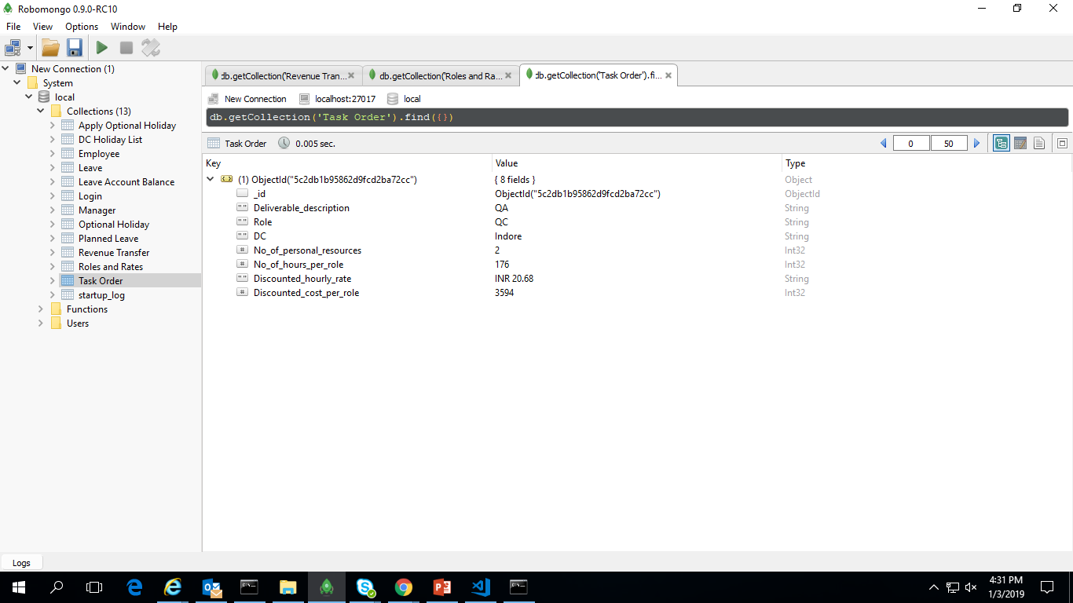

Slide 34
IX . Location Table
1.Country:-Varchar
2.City:-Varchar
3.DC:-Varchar

Slide 35
